Slide 1
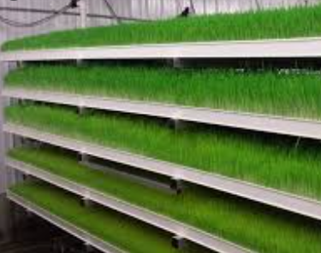
Uruhimbi Kageyo Cooperative
THE UKC CIRCULAR ECONOMY
STORY
By Jackson Sylvestre KARARA
UKC- Managing Director
Website: www.ukc.rw Phone: +250787451847

Slide 2
Uruhimbi Kageyo Cooperative
BACKGROUND
UKC is a youth run entity composed by university graduates mandated to cultivate and supply hydroponic green fodder to livestock farmers. It was formed in 2019 and started operations in 2020.
1
2
UKC is located in Northen province province of Rwanda, Gicumbi District, Kageyo Sector. UKC team, has grown from the initiators (founding members) to an aptly innovative and productive young-blooded technical team.
UKC has green climate resilient technologies of hydroponics fodder, that is soilless, vertical, and water recycled system in greenhouse. We have managed to supply cost-effective, nutritious and sustainable animal feeds to livestock farmers in Gicumbi district.
3

Slide 3
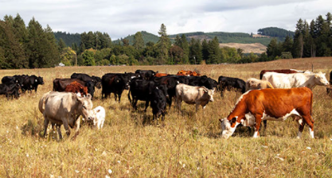
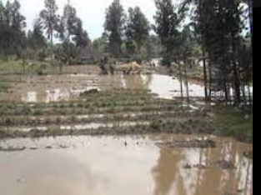
Uruhimbi Kageyo Cooperative
PROBLEM ADDRESSING
Small land sizes
Negative Climate-Shocks
High cost of animal feeds
Youth unemployment
Malnutrition.

Slide 4
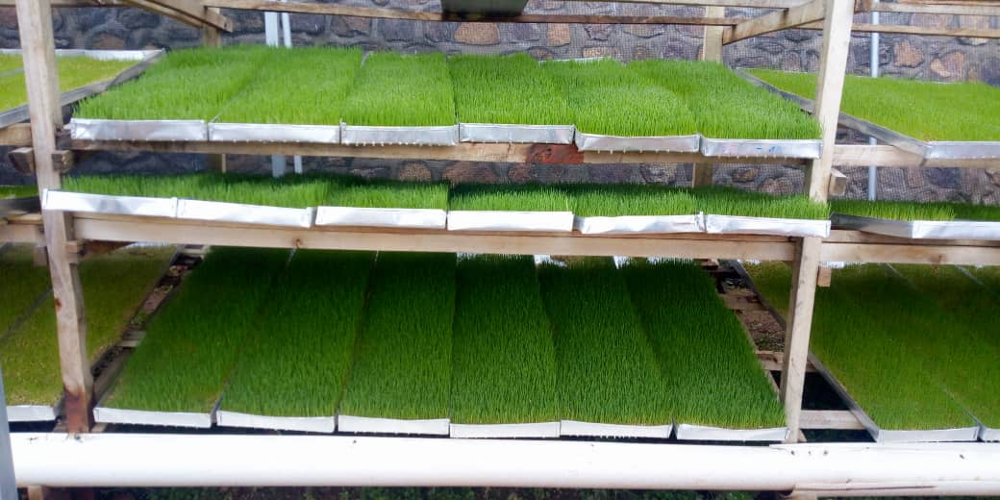
Uruhimbi Kageyo Cooperative
SOLUTION
Adoption and mainstreaming Hydroponic technologies in Agriculture

Slide 5
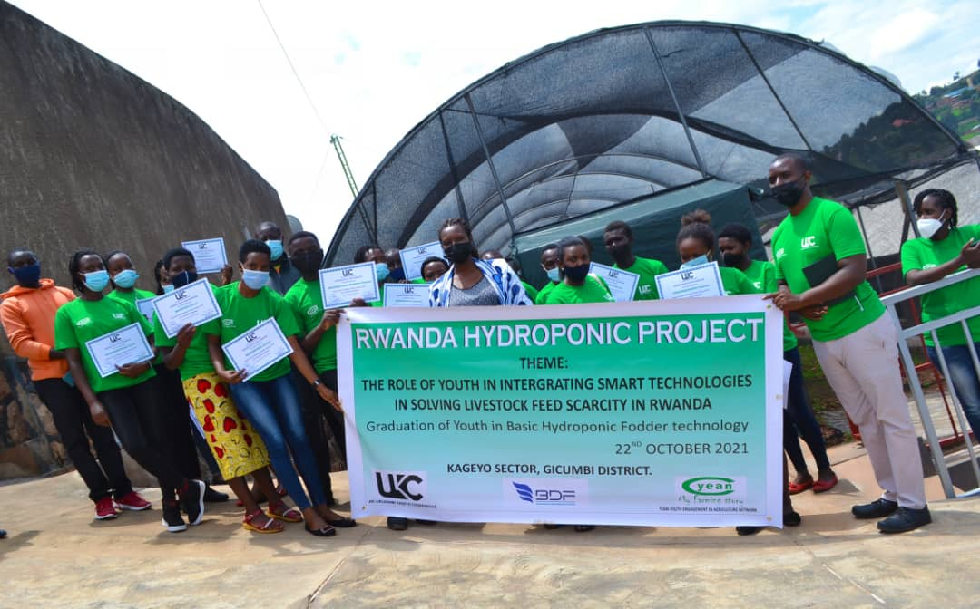
Uruhimbi Kageyo Cooperative
ACHIEVEMENTS
1
2
Team recruitment ( Technical TEAM)
Greenhouse established and fully operational
3
4
Started production and selling ( 85%)
Infrastructure development
( hostels, training hall, kraals)
5
Establishment of Demonstration Center

